Slide 1
The Dangers of the Change Approval Processes
Web-420

Slide 2
What is the ‘Change Approval Process’?
The process of any change to an application - from development to production
Depending on the type of change, it can incorporate several stages of approval
Can be a rather tedious or slow process

Slide 3
Change Management Information
Can often be a frustrating part in IT Organizations
Can cause delays and block projects
Can often defer or deny proposed changes
Companies may try to reduce delays by improving efficiency of the change management process
Oten times there is an ‘us and them’ situation when some teams are trying to implement changes and others block them

Slide 4
Using Standard Changes for Efficiency
Use Standard Changes
Well defined & low risk changes that are pre-approved
People do not need to wait for permission to make changes
Personnel follow an agreed process
Change could be replacing equipment with a newer model
Could increase the amount of storage

Slide 5
Efficiency Changes Continued...
Delegating Change Authority
Giving someone authority to approve lower risk changes
Authority for authorizing installation of firmware updates
Using Change Models
Predefined steps to implement a change
Save time and Effort when changes are reviewed, approved and implemented
Make sure everyone knows order of updates

Slide 6
End-to-End Processes
Understand change management is part of a business process (not just an IT process)
Deploy IT functionality to support customers;
Change Authorization needs to be viewed as part of the end to end workflow
Collaborate and create a process where changes flow into production
Include change authorization as part of the wider process and not as an add-on activity

Slide 7
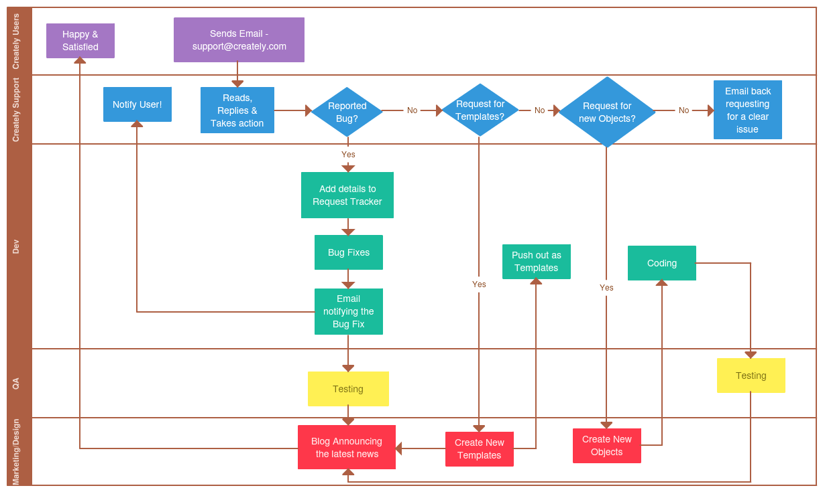
End to End Process for Change Approval
(Creatly, 2019)

Slide 8
Benefits for Change Approval
Design and map change management activities for groups - these can be different and individualized
Speed is increased with deployment of efficient change requests
Reduces the chances of mistakes made in a hurry
Less chance of emergency changes
More accuracy on assessing business & customer impact

Slide 9
Change Request Process Thoughts
Software Changes impact entire companies - this can affect customers
Being proactive is best - identify and mitigate risks in a timely manner
Involve stakeholders in implementation of initiatives
Change processes can speed up deployment & prevent disruptions

Slide 10
References
Rance, S. (2017, January 24). How to make IT change management work for everyone. Retrieved February 7, 2020, from https://www.optimalservicemanagement.com/blog/how-to-make-it-change-management-work-for-everyone
Saunders, J. (2017, October 9). IT Change Request Process: Best Practices. Retrieved February 7, 2020 , from https://www.processmaker.com/blog/workflow-processes/it-change-request-process-best-practices/
Kim, G., Debois, P., Willis, J., Humble, J., & Allspaw, J. (2017). The DevOps handbook: How to create world-class agility, reliability, and security in technology organizations. Portland, OR: IT Revolution Press, LLC.

